Slide 1
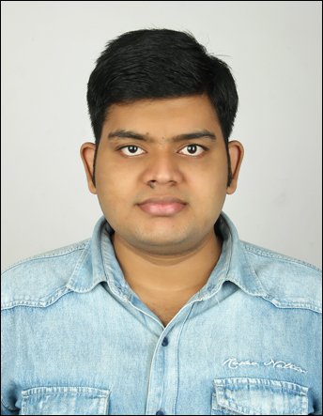



Nagireddy Janaki Ram
Analyst/Software Engineer
Bachelor of Technlogy, Computer Science and Engineering:2016 - 20
Skills
Java | Java Basics, OOPS, Generics, Collections, Arrays, Loops
C# | C#Basics,OOPS,Generics,Collections, Array,Loops,LINQ
.NET | ADO.NET,ASP.NET with MVC5 and WEB API,Entity Framework
Database | MySQL
Tools | Git, Postman, Swagger, Visual Studio, Visual Studio Code
Add On skills | Peer learning
Python | Intermediate
Bengaluru
NAGIREDDY.JANAKIRAM@capgemini.com
9849596097
A4
Full Stack Developer training on dotNet
. Git and GitHub
SQL and RDBMS
C# Intermediate
ADO.net, Entity framework, LINQ.
ASP dotNet Core Web App(MVC)
Asp dotNet Core Web API
HTML, CSS , JavaScript , Typescript
Angular
Ongoing training on Azure
Created a Online Shopping Cart Application With MySQL
Backend and WebAPI Core as middleware and Angular
as frontend Used HTML, CSS and TypeScript for the
deigning.
Check out my work on GitHub

